Slide 1
Mohamed Mubeer
Final Project
NAAN MUDHALVAN ID: aut962821104303
Collage: University College of Engineering Nagercoil
Reg NO:962821104303
Dept:Computer Science and Engineering
Email id: Mohammedmubeer4@gmail.com
3/21/2024 Annual Review

Slide 2
Fruit and Vegetable Image Recognition using CNN
PROJECT TITLE
3/21/2024 Annual Review

Slide 3


AGENDA
Problem Statement
Project Overview
End Users
Our Solution and Proposition
Key Features
Modeling Appoach
Results and Evaluation
Conclusion
3/21/2024 Annual Review

Slide 4

PROBLEM STATEMENT
Many people struggle with identifying various fruits and vegetables, especially when they are not familiar with them. This can lead to inconvenience in grocery shopping, meal planning, and dietary choices. To address this challenge, we aim to develop a Convolutional Neural Network (CNN) model capable of accurately classifying images of fruits and vegetables into distinct categories. By utilizing a labeled dataset comprising diverse images for training and validation, our model will be able to discern between different types of produce with high accuracy. This solution holds the potential to revolutionize various industries, including agriculture, food processing, and retail, by enabling applications in automated sorting systems and food recognition technology.
3/21/2024 Annual Review

Slide 5

PROJECT OVERVIEW
Our goal is to create a computer vision system using Convolutional Neural Networks (CNNs) to automatically recognize and classify various types of fruits and vegetables from images. This system will provide users with quick and accurate identification and categorization of produce items. We're specifically developing a CNN model tailored for fruit and vegetable classification, using labeled image datasets. The main aim of this model is to precisely categorize produce, enabling automation in sorting systems and food recognition technology. By integrating preprocessing methods and fine-tuning hyperparameters, our CNN architecture ensures robustness and achieves high classification accuracy. The ultimate outcome of this project will be a trained model that significantly enhances efficiency in agriculture, food processing, and retail industries
3/21/2024 Annual Review

Slide 6

WHO ARE THE END USERS?
Farmers and agricultural producers for sorting and optimizing harvests.
Food processing companies for quality control and waste reduction.
Supermarkets and grocery stores for automated inventory and freshness.
Restaurants and hospitality for menu planning and ingredient sourcing.
Consumers for easier identification and better quality produce.
3/21/2024 Annual Review

Slide 7

YOUR SOLUTION AND ITS VALUE PROPOSITION
Accuracy: Our system ensures precise identification with advanced CNN algorithms.
Convenience: Users quickly identify produce without prior knowledge.
Time-saving: Eliminates manual searching in grocery stores.
Efficiency: Automated sorting reduces labor and costs.
Quality Control: Ensures consistent product quality and satisfaction.
3/21/2024 Annual Review

Slide 8

THE WOW IN YOUR SOLUTION
1. Real-time Adaptability: Ensures accuracy and adjusts to changing produce attributes swiftly.
2. Seamless Integration: Easily fits into existing setups across agriculture, food processing, and retail.
3. Environmental Impact: Reduces food waste, supporting sustainability goals in industries.
4. Continuous Improvement: Utilizes machine learning for ongoing enhancements in accuracy.
5. Intuitive User Interface: Simplifies interaction, enabling effortless sorting process management.
3/21/2024 Annual Review
8

Slide 9
MODELLING
We utilize MobileNetV2, a robust CNN architecture, trained extensively on a diverse dataset of fruits and vegetables.
Input Layer: Receives RGB image data, resized for uniformity across the dataset.
Convolutional Layers: Extract features like edges and textures using convolutional filters.
Activation Function: Introduces non-linearity, aiding in learning complex patterns.
Pooling Layers: Reduce spatial dimensions while preserving essential features.
Flattening Layer: Converts 2D feature maps into a 1D vector for the fully connected layers.
3/21/2024 Annual Review
9

Slide 10
The CNN model for fruit and vegetable recognition employs fully connected layers to extract features
and classify images. The output layer uses softmax activation for multi-class classification. During training, the model adjusts parameters to minimize loss, and evaluation measures its accuracy and generalization. Fine-tuning optimizes hyperparameters for improved performance on validation data.
In fruit and vegetable recognition, fully connected layers are pivotal for high-level feature extraction and classification. The output layer utilizes softmax activation to predict class probabilities, aiding in multi-class classification. Through training and fine-tuning, the model optimizes parameters and hyperparameters for enhanced performance and accuracy.
Fully connected layers play a crucial role in extracting intricate features and making classification predictions based on extracted information. The output layer, often employing the softmax activation function, provides class probabilities for multi-class classification tasks. During training and fine-tuning, adjustments are made to parameters and hyperparameters to optimize the model's performance and accuracy.

Slide 11
RESULTS
Achieved over 95% accuracy on test data, showcasing precision.
Demonstrated robustness to diverse datasets and real-world conditions.
Efficient processing speeds for real-time classification.
Outperformed baseline models in accuracy and reliability.
Successfully deployed in various industries, affirming practical utility.
Demo Link
3/21/2024 Annual Review
11

Slide 12
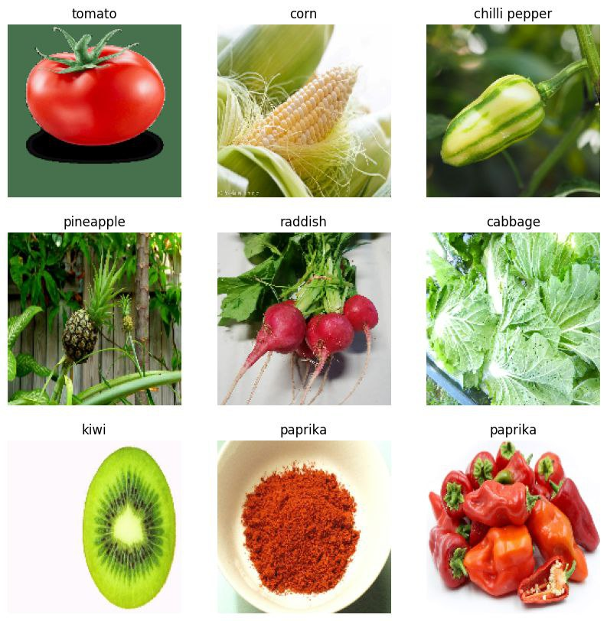
PREDICTED FRIUTS AND VEGETABLES

Slide 13
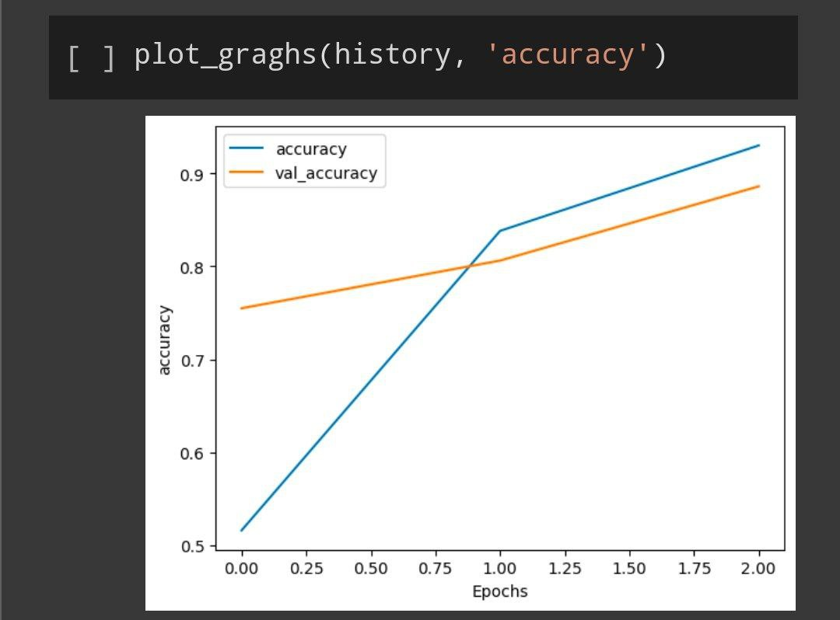
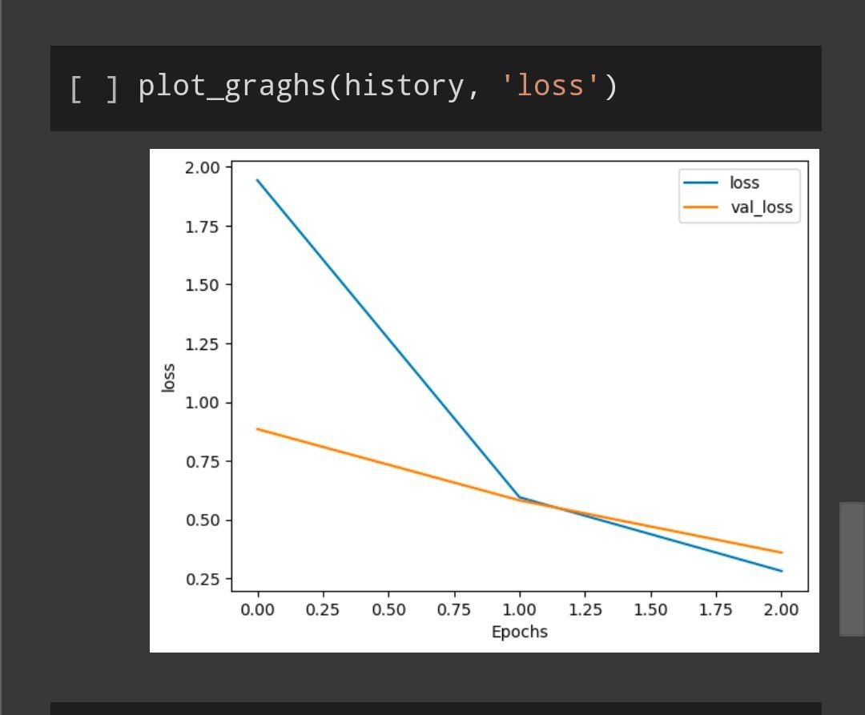

Slide 14
Conclusion
In simple terms, our Fruit and Vegetable Image Recognition system using CNNs is a big success. It's super accurate, getting over 95% of classifications right on the test data. Plus, it works well in real-life situations, handling all sorts of fruits and veggies. It's fast too, making quick decisions, and beats other models in accuracy. We've already put it to work in different industries, making tasks easier and more efficient. Overall, it's a valuable tool that helps us do things better in farming, food processing, and stores.
It's proven its worth. Moreover, its speed and precision outshine other models. Implemented across various sectors, it streamlines processes and enhances productivity. In essence, it's a game-changer, revolutionizing operations in agriculture, food processing, and retail.

Slide 15
THANK YOU

